Slide 1
UNO
Arvin Ghanizadeh, Antonio Gonzalez Hernandez, Melany Martinez, Cheuk Lun Tang

Slide 2
Features of our Project
Deck management: creation, shuffling and distribution.
Game room management: creation, joining
Sign-up:
Page User can create an account by entering email, username, and password.
Game Room:
User can see players, usernames, and card counts.
User can view the last played card in the discard pile.
User can draw from the draw pile.
User can play a selected card.
User can call UNO when they have one card left.
User can exit the game and return to the lobby.
Signed out landing:
User can Login back,
User can see active player count

Slide 3
Technology used in our project
Javascript
Typescript
Node
Html
CSS
Render, Node.js, Express.js, Postgres(required)

Slide 4
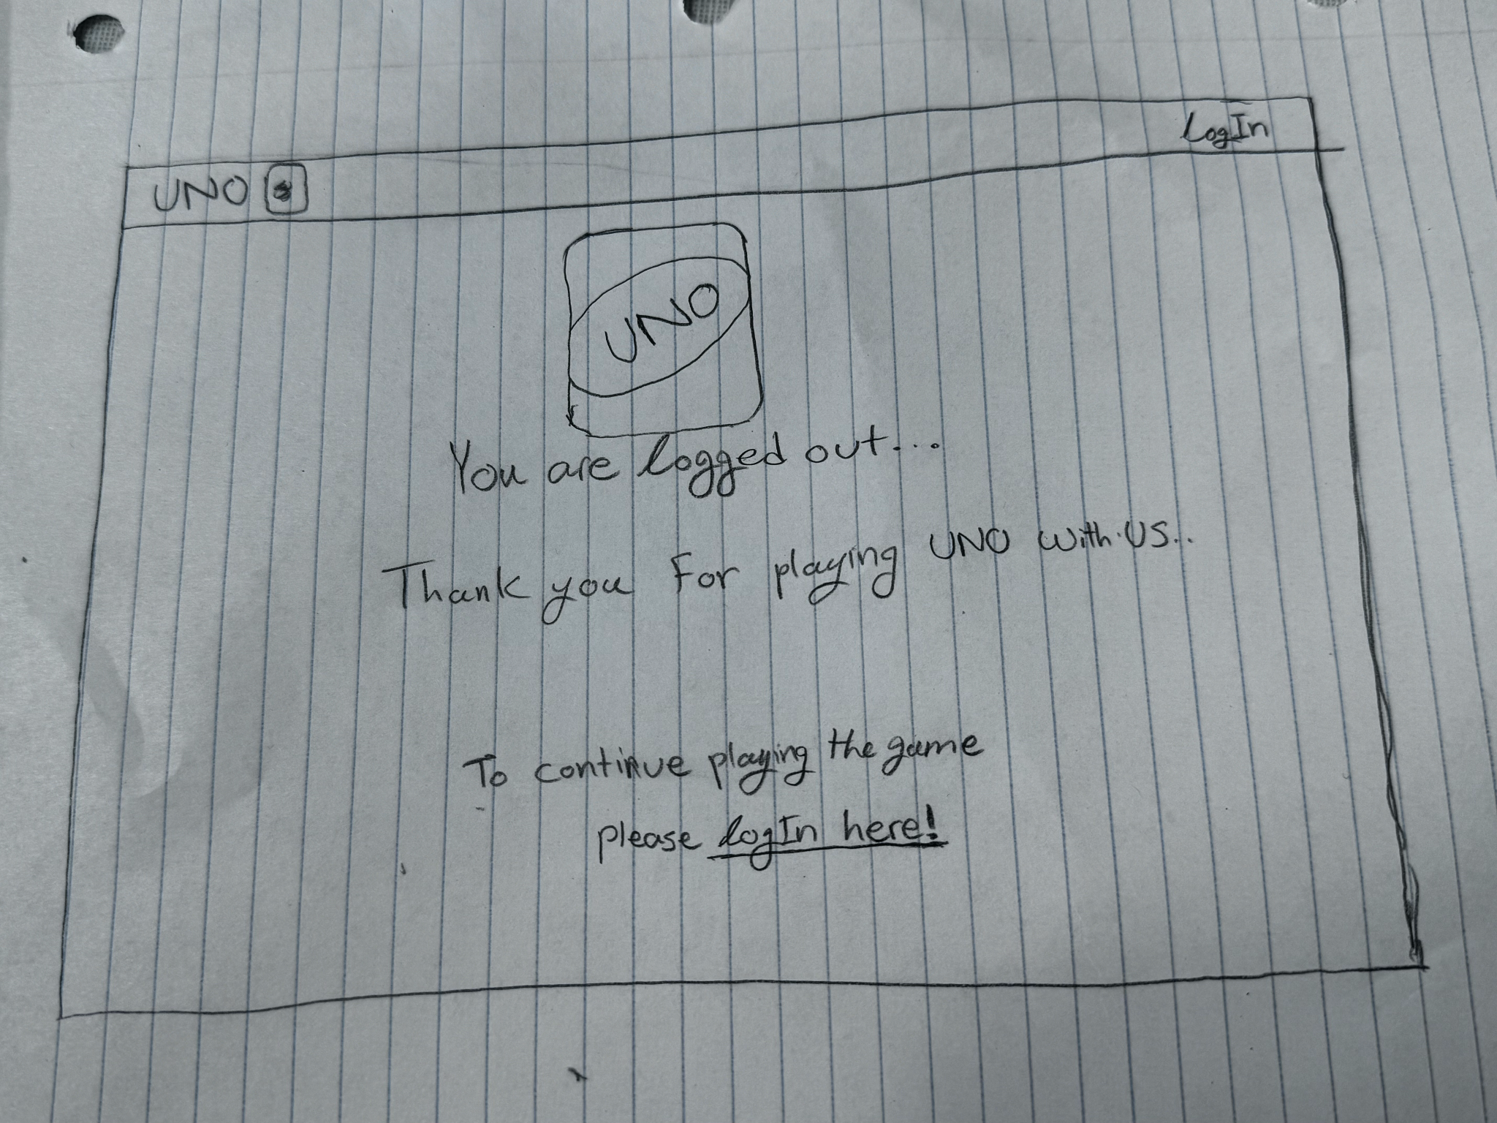
Signed out landing

Slide 5
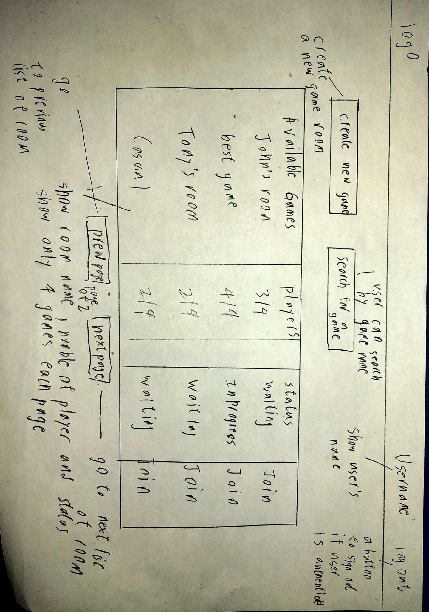
Signed in Landing

Slide 6
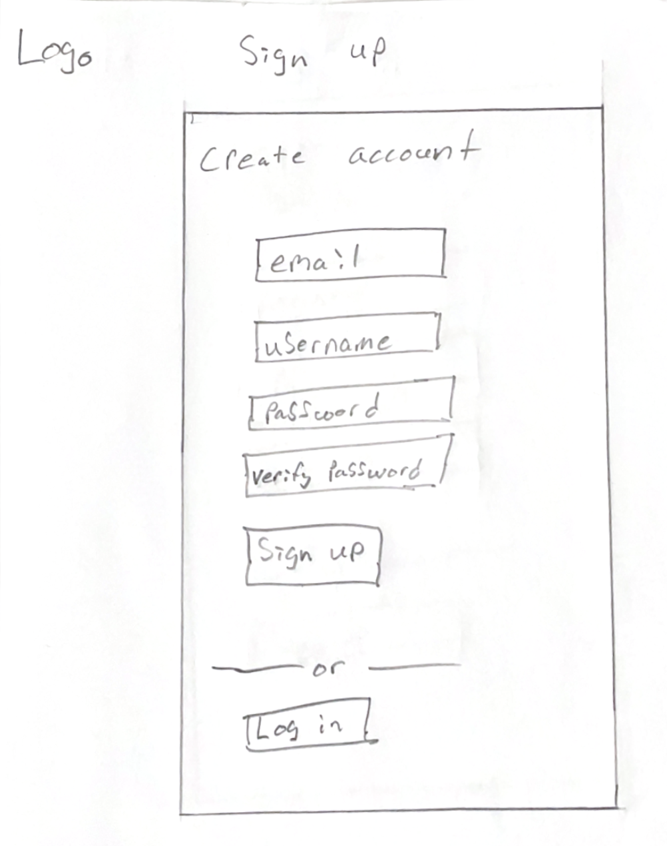
Sign up

Slide 7
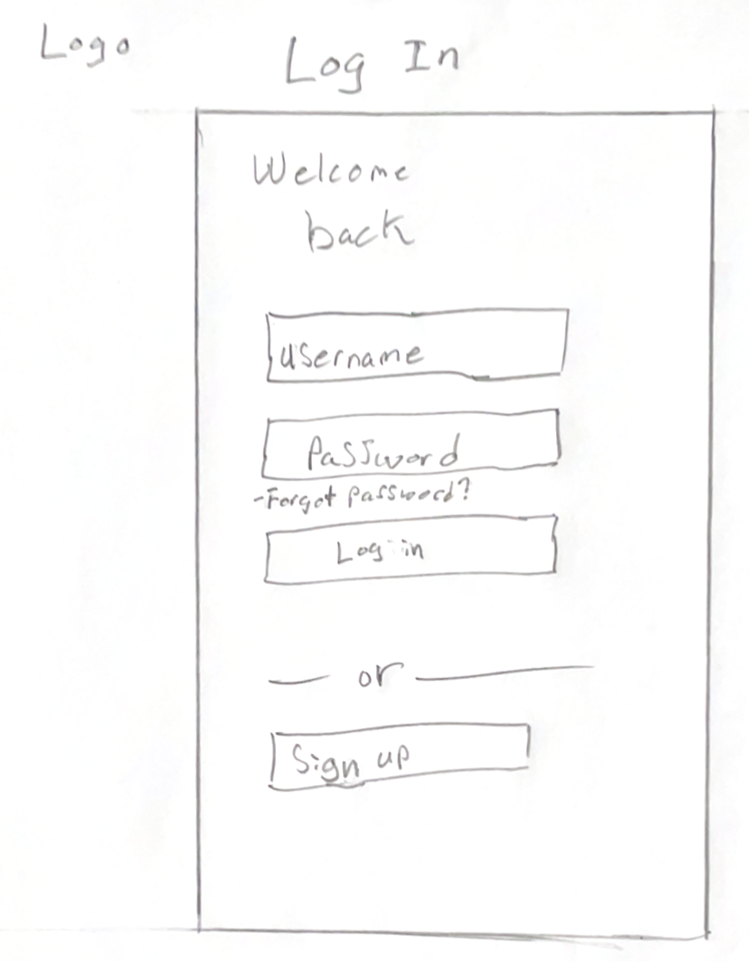
Log in

Slide 8
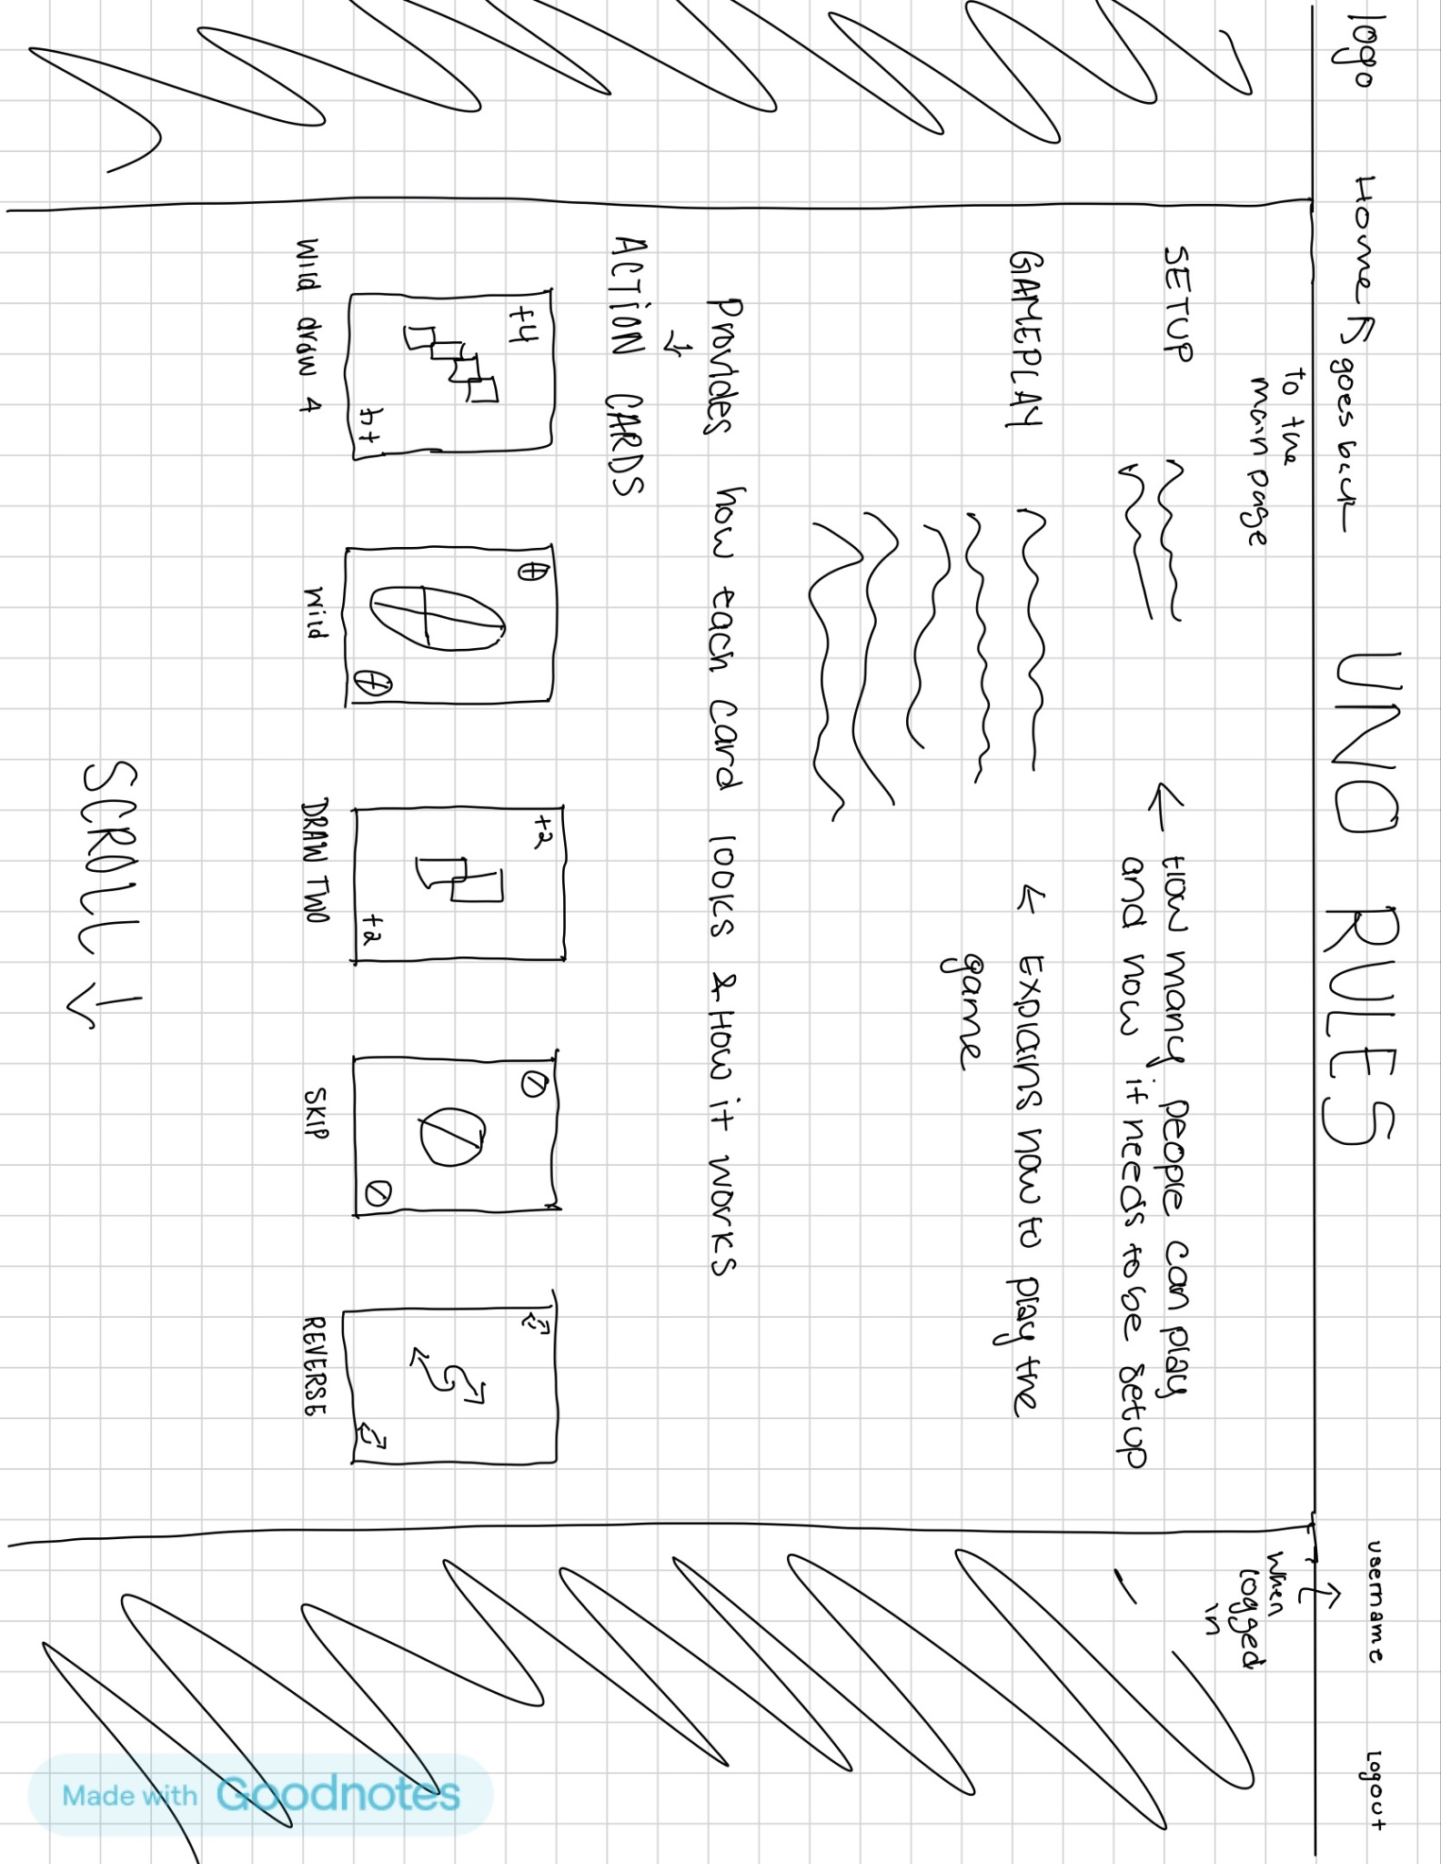
Game instructions Part 1

Slide 9
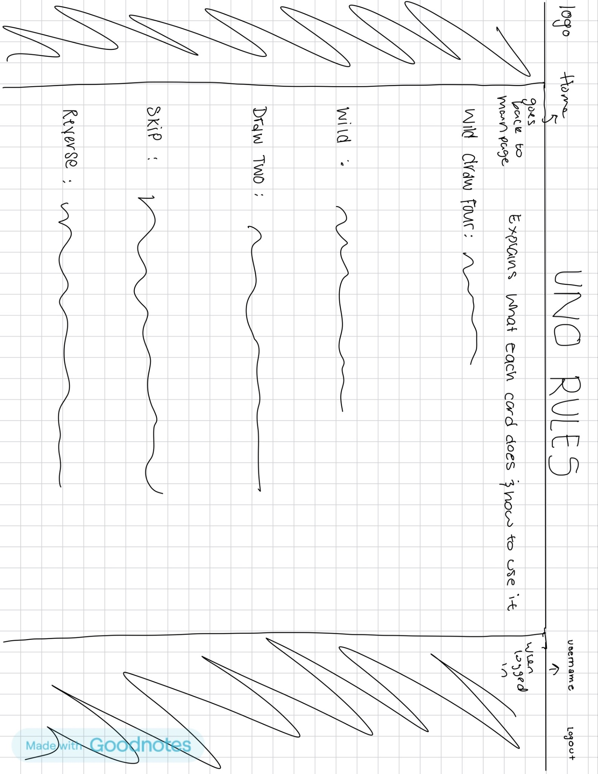
Game Instructions Part 2

Slide 10
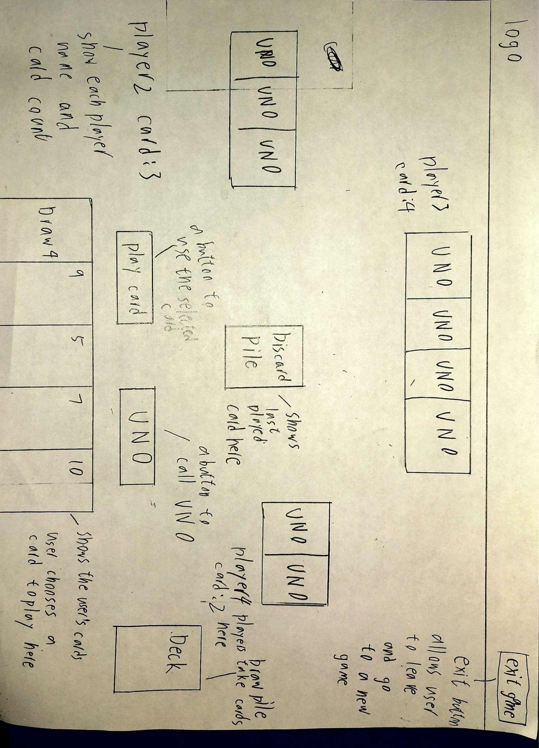
Game Room

